Slide 1

Global IR and EU
EU and the Middle East
Assist. Prof. Ferit Belder
Dec 20, 2023

Slide 2
Content of the Lecture
Historical Perspective
EU Actorness in the Region: One Europe or Many?
Power conceptualization and the European Involvement
Arab-Israeli Relations & Iranian Nuclearization & Syrian and Libya Civil War & Migration and refugees

Slide 3
Historical Perspective
First Phase : colonial legacy & the establishment of the modern Middle East state system
Second Phase: the retreat of the European power & cold war dynamics
Third Phase: the return of Europe as a ‘different’ actor: The EU
Fourth Phase: Arab Spring and aftermath

Slide 4
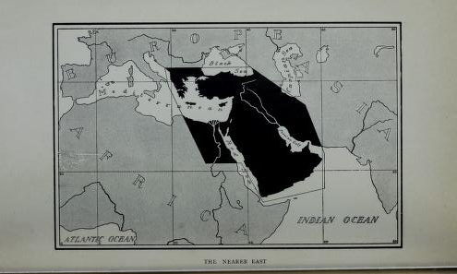
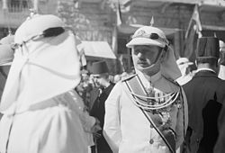
First Phase
The Birth of the Middle East as a European Invention
Geographical and Idelogical Roots of the Term ‘Middle East’
Geopolitics and geoeconomics
Colonial Legacy and Statecraft (The rise of nationalism in interwar period)

Slide 5
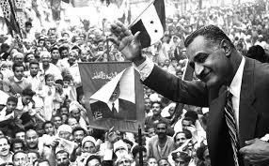
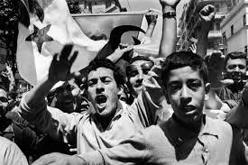
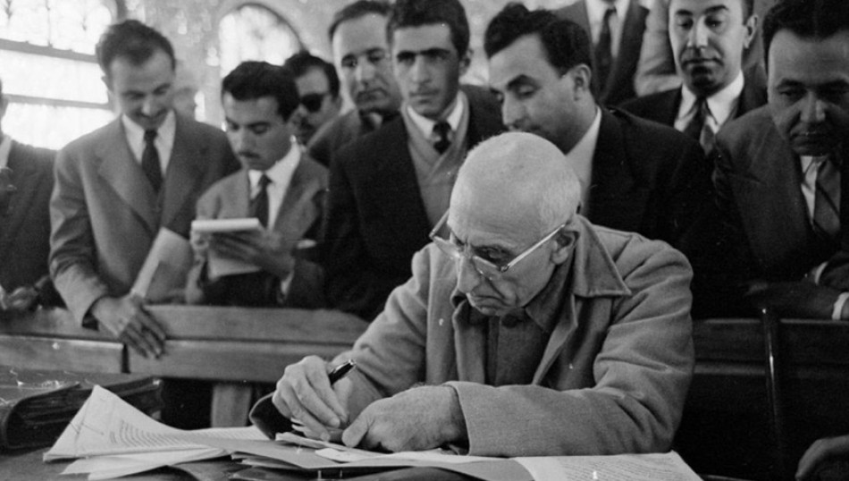
Second Phase
The Retreat of the European Powers during the Cold War
Anti-imperialist struggle across the world: Suez crisis, the war of Algerian independence, the establishment of the UAE, nationalization of oil in Iran
Europe under the shadow of the US

Slide 6
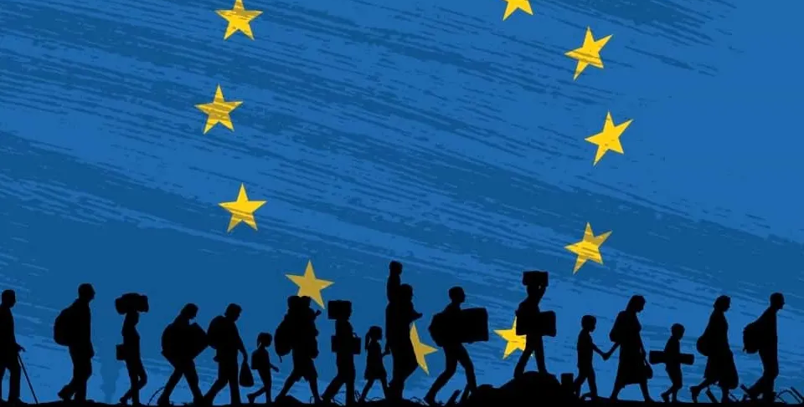
Third Phase
Rebirth of Europe in the Middle East Politics: A Different Power?
First Gulf War and the United Nations
Economic engagement in the region (relations with the GCC)
Support for political reforms in Iran
Second Gulf War: Britain vs. the Union
EU’s ‘figting against terrorism’ vs. US’ ‘war on terror’
EU in Mediterranean
Middle East Peace Process

Slide 7
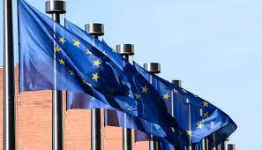
Power Conceptualization and the European Engagement
What is power?
Hard & Soft Power (democracy promotion & mediation)
Normative power? The Challenges toward the Normative Position of the EU
Is there a clash between EU and European states in Middle East engagement?

Slide 8
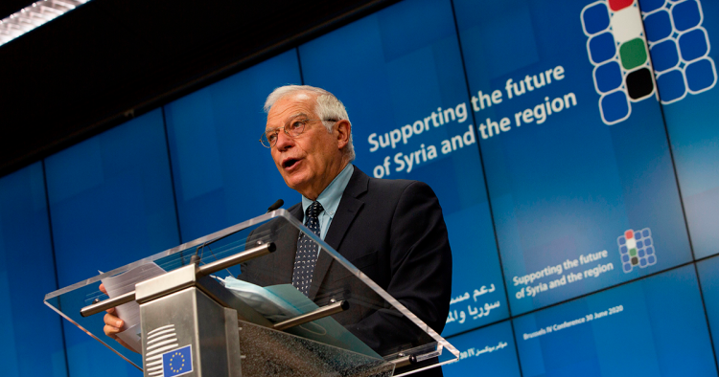
Syrian Civil War
Multidimensional approach (diplomatic, economic and humanitarian aspects)
The Lack of Military Engagement and the limits of diplomatic influence (international and regional reasons)
EU stretegic objectives in Syria
1-) An end of the war and the beginning of a political transition
2-) Strenghtening political opposition
3-) Humanitarian aid
4-) Democracy promotion, human rights, freedom of speech (strengthening çivil society organizations
5-) Accountability for war crimes
6-) Supporting the resilience of Syria’s population and society

Slide 9
Libyan Civil War
Limited military engagement
NATO intervention
Disagreements with other regional actors like Turkey and Russia
Internal divisions among Libyan actors

Slide 10

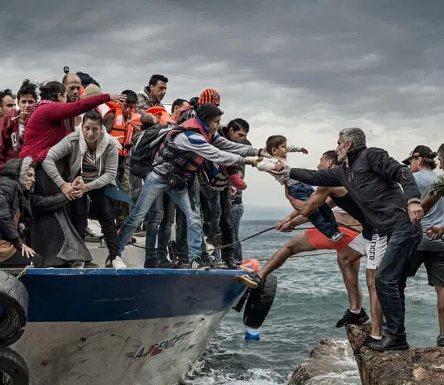
Refugees and Migrants
Securitization of migration
EU border security measures (dependency on neighbours)
Humanitarian crises across the MENA region
Refugee Dilemma (challenge to its normative stance)

Slide 11
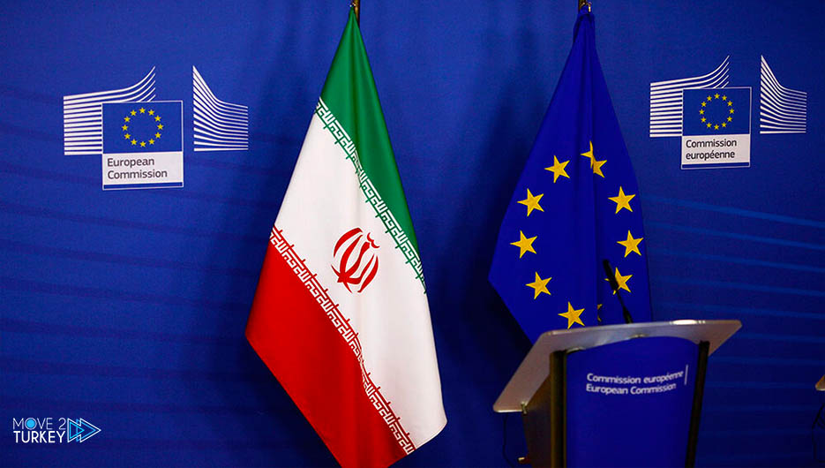
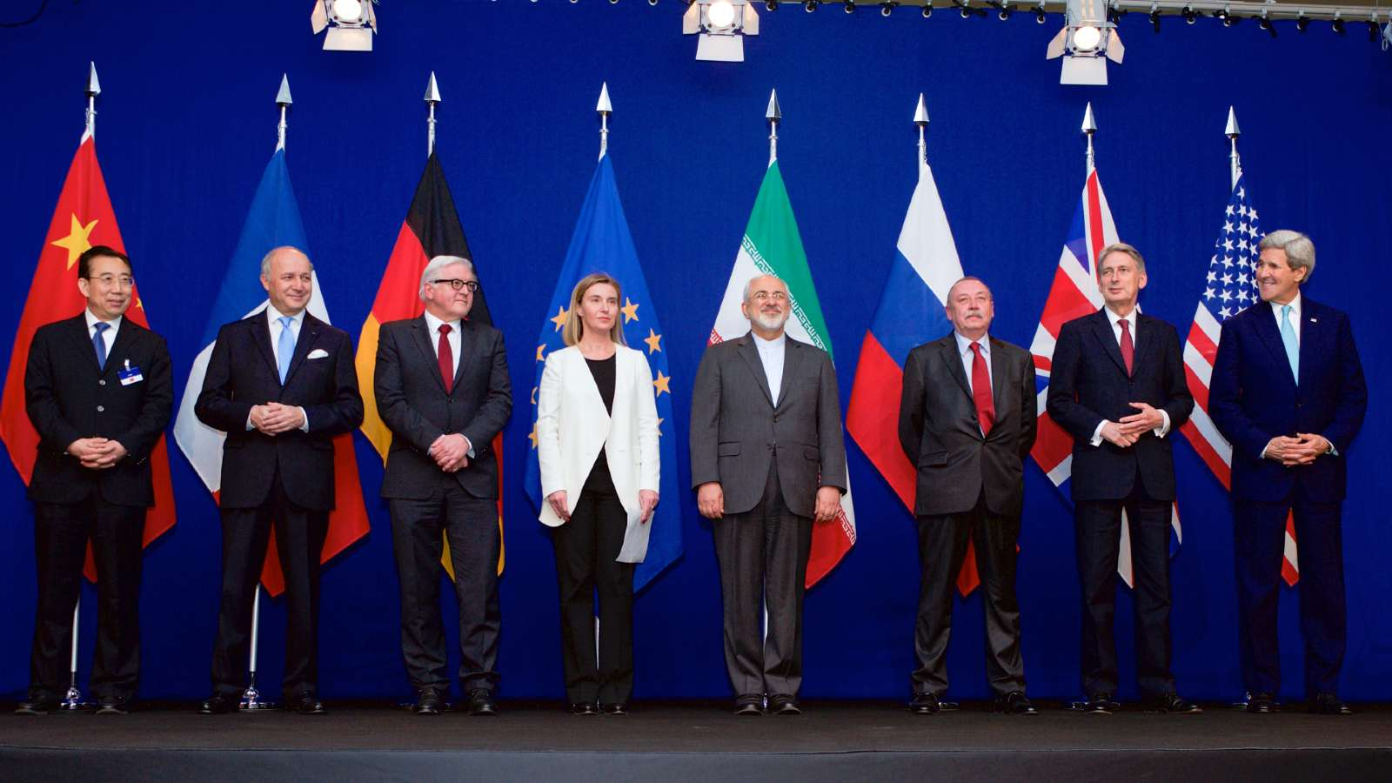
Nuclearization of Iran
EU is part of the Joint Comprehensive Plan of Action
EU adopted economic and financial sanctions on Iran before the deal
1) Restrictions of the trade of goods
2) Restrictions in the financial sectors (freezing the activities of Iranian banks)
3) Measures in the transport sector
To what extent the EU survive the deal without the support of the USA?

Slide 12
Arab Israeli Conflict
More balanced approach than the American administration
Resume peaceful dialogue and respect the rights and freedom of Palestinians.
Committed to the two-state solution. Rejects any kind of change (except those agreed between Israel and Palestine) to the 1967.
Settlement project is condemned by the EU and seen as one of the biggest obstacles to the peace.
A criticial approach to the Israeli use of force in the West Bank (disproportinate and excessive)

Slide 13
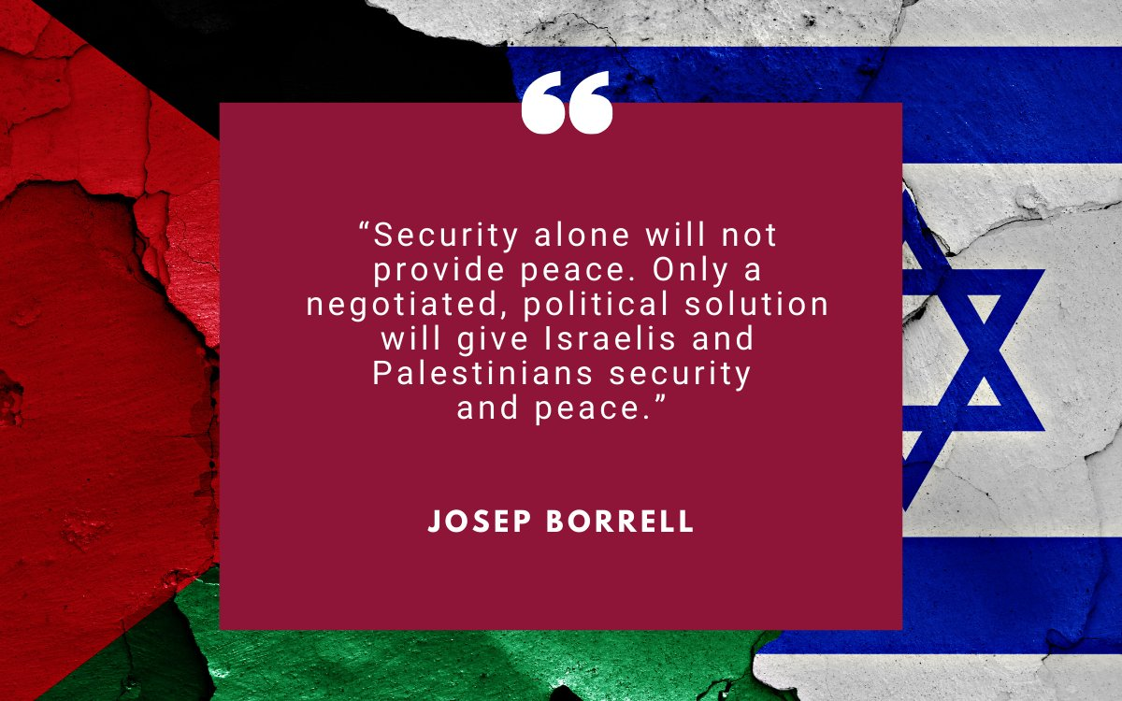

Slide 14
Arab Israeli Conflict
Part of Middle East Quartet (with the UN, the US, Russia)
EU and PA partnership (political infrastructure)
EU as a passive player?
Division among the members
Post Oct 7 Attacks: A Pro-Israel turn?

Slide 15
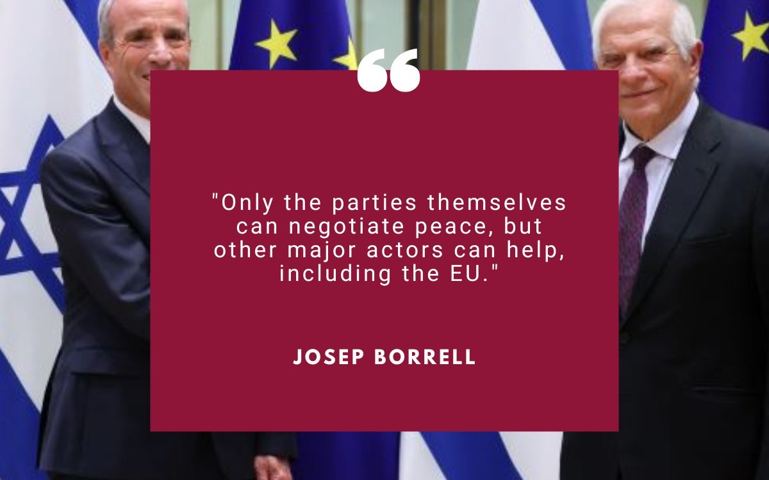

Slide 16
Conclusion & Discussion Questions
To what extent does the EU have capacity to increase its influence in the region?
What could be the limitations of the EU policies in the Middle East?
What are the challenges to the EU normative power?

