Slide 1

Global IR and EU
The EU in the Arctic
Assist. Prof. Ferit Belder
Dec 27, 2023

Slide 2
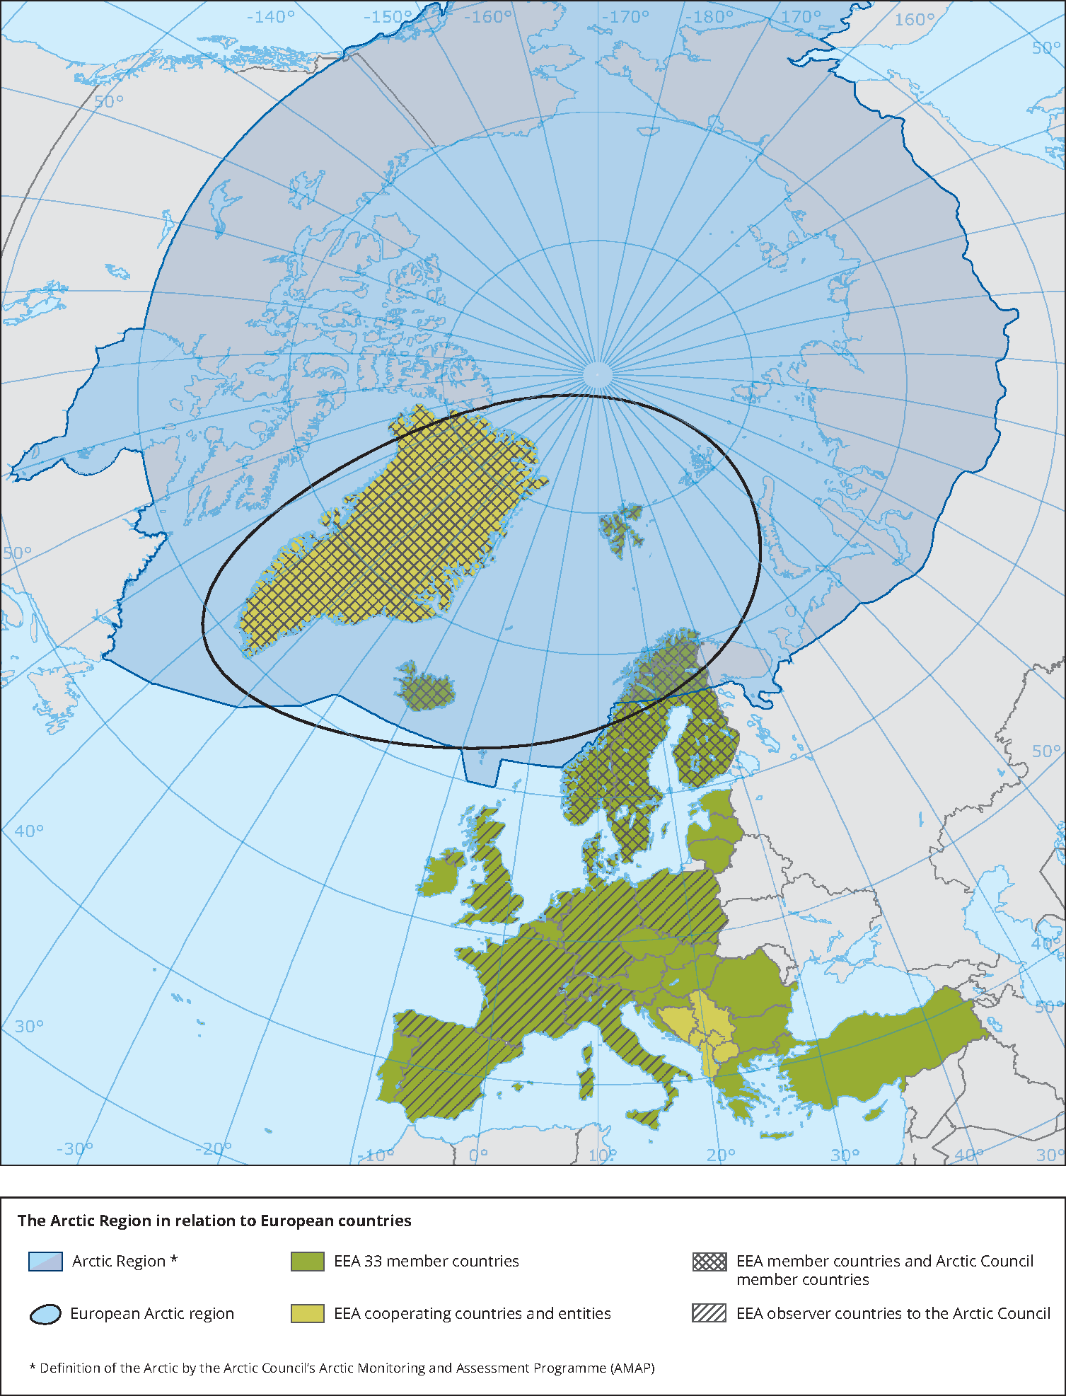
Introduction
As a geopolitical power, the EU has strategic and day-to-day interests, both in the European Arctic and the broader Arctic region
Defined Objectives
- Multilateral cooperation in the Arctic (safe, stable, sustainable, peaceful and prosperous region)
- livelihood of inhabitants, including Indigenous Peoples

Slide 3
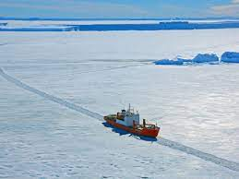
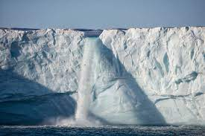
New Realities, New Rivalries
Climate change and the emergence of the new geopolitical space
Arctic states, non-Arctic states and international organizations
Reflections of the multipolar world
The EU’s full engagement in Arctic matters is a geopolitical necessity .
Intensified interest in Arctic resources and transport routes could transform the region into an arena of local and geopolitical competition and possible tensions, possibly threatening the EU’s interests (the rising interest of the external world) (2021)

Slide 4
New Realities, New Rivalries
2016 Global Strategy for the European Union’s Foreign and Security Policy and the political priorities of the Commission
Joint Communications on Arctic matters
contributing to maintaining peaceful and constructive dialogue and cooperation in a changing geopolitical landscape, to keep the Arctic safe and stable, by raising Arctic matters in its external contacts, intensifying regional cooperation and developing strategic foresight on emerging security challenges;
addressing the ecological, social, economic and political challenges arising as a consequence of climate change and taking strong action to tackle climate change and environmental degradation, making the Arctic more resilient, through environmental legislation, concerted action on black carbon and permafrost thaw, and by pushing for oil, coal and gas to stay in the ground, including in Arctic regions;
Supporting the inclusive and sustainable development of the Arctic regions to the benefit of its inhabitants and future generations, focusing on the needs of Indigenous Peoples, women and the young, and investing in future-orientated jobs and the blue economy.

Slide 5
Historical Background
Relations with Greenland
2008 Climate change and international security
2012 Joint Communication to the European Parliament and the Councıl Developing a European Union Policy towards the Arctic Region: progress since 2008 and next steps
"The Arctic is an area of growing strategic importance. Its changing landscape is opening up new transport lanes and the exploitation of natural and mineral resources, like oil and gas. Extending from Europe to Asia, the Northern Sea Route could shorten the time taken by cargo vessels to travel between the Pacific and the Atlantic by about one third.”
2016 An integrated European Union policy for the Arctic
“The integrated policy for the Arctic aims at boosting the EU's profile in the region. It proposes 39 actions to structure the EU policy in the region with strong focus on sustainable development, environment and climate change research, and engagement with Arctic states and indigenous people.”
2021 Joint Communication on a stronger EU engagement for a peaceful, sustainable and prosperous Arctic
” The Arctic is an area of growing strategic importance. Its changing landscape is opening up new transport lanes and the exploitation of natural and mineral resources, like oil and gas. Extending from Europe to Asia, the Northern Sea Route could shorten the time taken by cargo vessels to travel between the Pacific and the Atlantic by about one third"

Slide 6

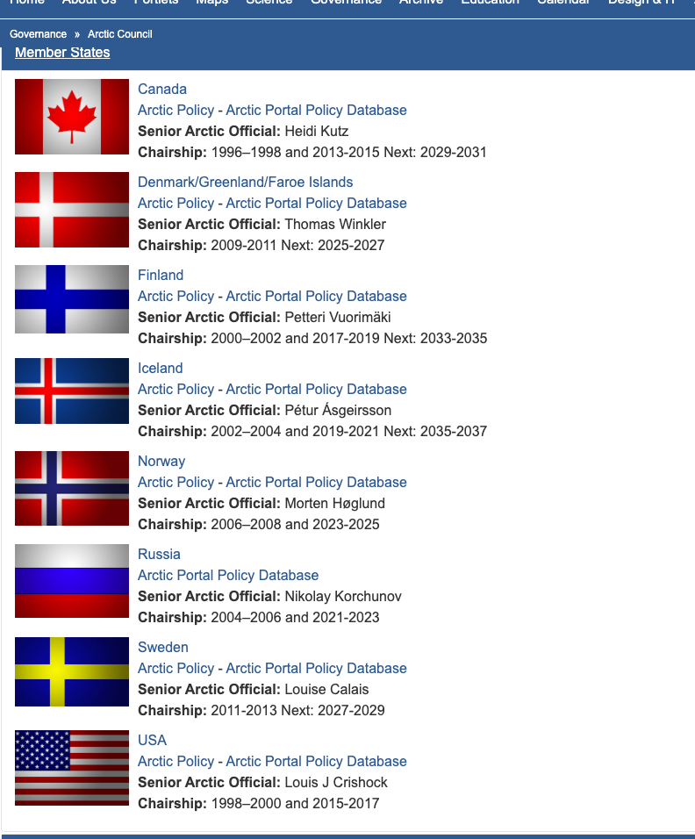
Arctic Council
Thirteen non-arctic countries have been admitted as Permanent Observer States to the Arctic Council
People´s Republic of China
France
Germany
Republic of India
Italian Republic
Japan
Republic of Korea
The Netherlands
Poland
Republic of Singapore
Spain
Switzerland
United Kingdom
Northern Dimension (EU, Iceland, Norway, Russia)

Slide 7
The EU in the Arctic
Geopolitics, Climate Change, Sea Transportation, Natural Resources, Fishery, Indigenous Population
GEOPOLITICS
Arctic as an arena of global competition
Military build-up across the Russian Arctic
An upturn in the activities of other actors, including China, and growing interest in areas like ownership of critical infrastructure, the construction of sea cables, global shipping, cyberspace and disinformation.
The increase in applications for observer status at the Arctic Council
2021 Strategic Foresight report: the security implications of the climatological changes in the Arctic region, and their impact on the global security environment. It will work with its partners, including the US, Canada, Norway and Iceland, and will also cooperate with NATO on strategic foresight, looking at the medium to longer term security impact of climate change and sharing studies and studies and data, as part of the broader ongoing exchange with NATO on climate change and security.
the EU Satellite Centre (SatCen) offers secured geospatial analysis

Slide 8
CLIMATE CHANGE AND ENVIRONMENTAL DEGREDATION
The EU will act against major sources of pollution affecting the Arctic regions in the air, on land and at sea, such as plastics/marine litter, black carbon, chemicals, and transport emissions as well as unsustainable exploitation of natural resources.
Climate change and biodiversity: two sides of the same coin
Addressing plastics/marine litter pollution
Promoting collective responses to reducing black carbon in the Arctic
Supporting the Arctic’s renewable potential
Curbing chemical pollution
Lowering the carbon and environmental footprint of maritime transport
Ensuring sustainable and responsible extraction and processing for climate-neutrality
Strengthening the Arctic’s ocean governance

Slide 9
CLIMATE CHANGE AND ENVIRONMENTAL DEGREDATION
CLIMATE CHANGE AND INTERNATIONAL SECURITY
Paper from the High Representative and the European Commission to the European Council (2008)
The rapid melting of the polar ice caps, in particular, the Arctic, is opening up new waterways and international trade routes. In addition, the increased accessibility of the enormous hydrocarbon resources in the Arctic region is changing the geo-strategic dynamics of the region with potential consequences for international stability and European security interests. The resulting new strategic interests are illustrated by the recent planting of the Russian flag under the North Pole. There is an increasing need to address the growing debate over territorial claims and access to new trade routes by different countries which challenge Europe's ability to effectively secure its trade and resource interests in the region and may put pressure on its relations with key partners.

Slide 10
NATURAL RESOURCES
Supporting the Arctic’s renewable potential: The Arctic as stable energy region (?)
Ensuring sustainable and responsible extraction and processing for climate-neutrality
FISHERY
INDIGENOUS POPULATION
10% of the Arctic population
Integration of Indigenous population in decision-making process
Promoting sustainable regional development
SEA ROUTES
New sea routes
Copernicus programme- active monitoring over the Arctic for security
Galileo (global navigation satellite system

